Slide 1

PCA for Portfolio Optimization
Prathamesh Thite

Slide 2

What is PCA?

Slide 3
Can we visualize data in 2-dimensions?

Slide 4
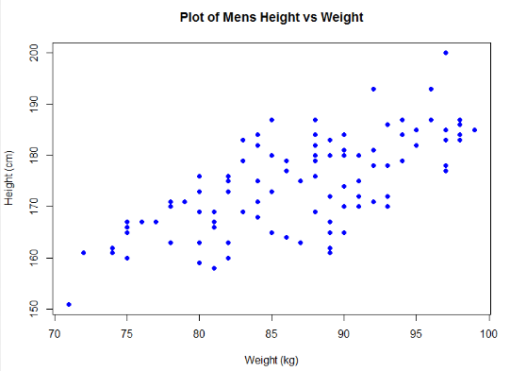
Offcourse!

Slide 5
Can we visualize data in 3-dimensions?

Slide 6
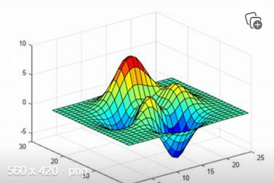
Offcourse, Yes

Slide 7
Can we visualize data in 100-dimensions?

Slide 8


Slide 9
Here Comes PCA in role
PCA (Principal Component Analysis is Dimension reduction technique while retaining the maximum information of the data.
It does this by finding the directions in which the data varies the most, and creating new variables that capture this variation known as principal components
These principal components are new variables that are a combination of the original variables, and they capture the most important information in the data(Loadings)

Slide 10
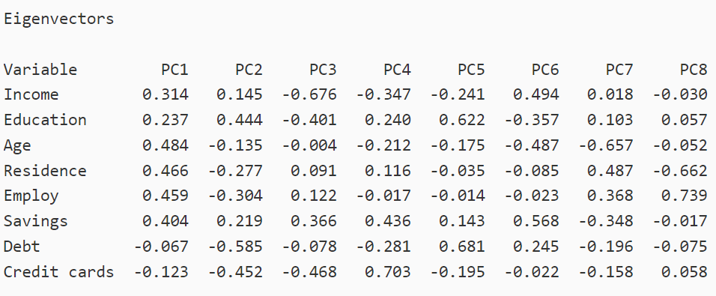
Explaining point (3)

Slide 11

Happy

Slide 12
What is Portfolio Optimization?

Slide 13

What if you carry all eggs in one basket?

Slide 14


Slide 15

Smart Girl

Slide 16
What is Portfolio Optimization?
Portfolio optimization is like choosing which eggs to place in which basket. Instead of eggs, you have a collection of investments, like stocks or bonds, and you want to choose the best ones to invest in so that you can make the most money.
To do this, you need to look at different factors like how much money you have to invest, how risky each investment is, and what kind of return you can expect. Then, you can choose a mix of investments that gives you the best chance of making a good return while also managing your risk.

Slide 17


Slide 18
DataSet
Let's take historical data of 15 stocks for last 1 year (Mar- 2022 – Mar 2023)
CSCO - Cisco
DLTR - Dollar Tree
INTC - Intel Corp
WMT - Walmart
NFLX - Netflix
PYPL - Paypal
EBAY - EBAY
EA - Electronics Arts
FTNT - Fortinet
INTU - Intuit
LCID - Lucid Motors
NVDA - Nvidia
TSLA - Tesla
WBD - Warner Bros
AAPL - Apple

Slide 19
Let's try to use PCA for solving Portfolio Optimization Problem

Slide 20
Steps in PCA
Standardization of the data
Computing the covariance matrix
Calculating the eigenvectors and eigenvalues
Computing the Principal Components
Reducing the dimensions of the data set

Slide 21
Concepts with meaning in PCA
Covariance_matrix
The covariance matrix captures the variance and co-variance between the different features of the input data. Covariance measures the magnitude of how one random variable varies with another random variable
The covariance matrix also provides information about the correlation between the different features of the data.
Highly correlated features tend to have similar contributions to the principal components, whereas features with low correlation have distinct contributions.
Thus, analyzing the covariance matrix can help to identify the most important features for a given analysis.

Slide 22
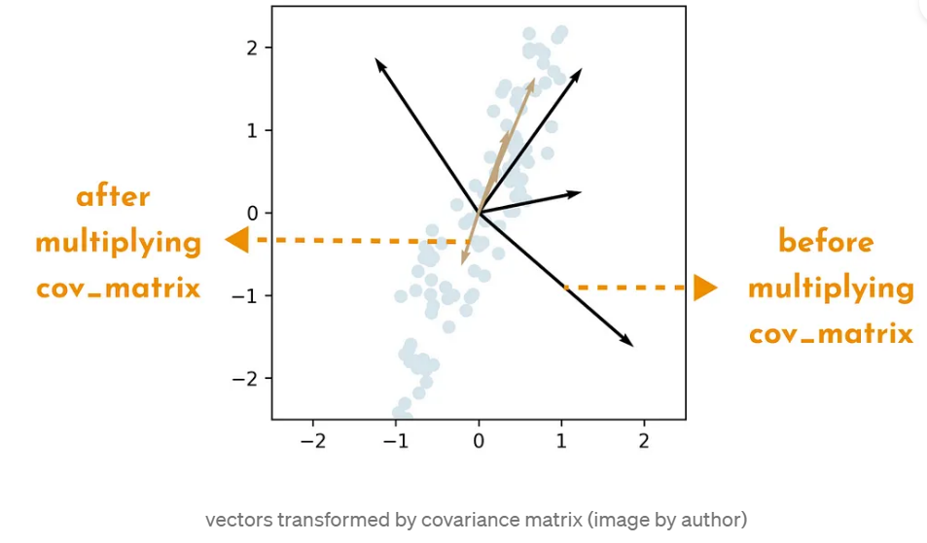
vectors after transformation

Slide 23
Eigenvalues
1) Eigenvalues are used to measure the importance of each principal component in the dataset
2) PCA identifies the principal components of a dataset by finding the eigenvectors of the covariance matrix of the data
3) Each eigenvector corresponds to a principal component, and the eigenvalue associated with that eigenvector represents the amount of variance in the data explained by that principal component
4) Higher eigenvalues indicate that the corresponding principal component captures more of the variance in the data and is therefore more important.
5) Eigenvalues help us determine which principal components are most important in representing the data, allowing us to reduce the dimensionality of the dataset while retaining as much of the original information as possible

Slide 24
Advantages of using PCA
One of the main issues when analyzing a high-dimensional data set is the overfitting: this happens when there are too many variables in the data set. Using PCA to lower the dimensions of the data set can prevent such an overfit
Correlated features removed
Speed up other machine learning algorithms
Improves visualization

Slide 25
Disadvantages of using PCA
We may lose some valuable information
Major components may be difficult to understand
When we implement the Principal Component Analysis to our data set, the original features will be transformed into principal components: linear combinations of features of the original data. But which features, variables or characteristics are the most significant in the data set? This question can be difficult to answer after computing the PCA.

Slide 26
Resources
https://numpy.org/
Class Notes
Principal Component Analysis (PCA) Explained | Built In

Slide 27


Thank You Dear Professor, TA, and Classmates
Prathamesh Thite
thite.p@northeastern.edu

